Slide 1
Paper Presentation
on
Unsupervised Translation of Programming Languages
Written By :
Baptiste Roziere
Marie-Anne Lachaux
Lowik Chanussot
Guillaume Lample
From Facebook AI Research
Presented By:
Niloy Deb Roy Mishu
ID: 17301081
Department of Computer Science and Engineering
BRAC University

Slide 2
Introduction
A transcompiler, also known as source-to-source translator, is a system that converts source code from a high-level programming language (such as C++ or Python) to another.
Typically, transcompiler rely on handcrafted rewrite rules, applied to the source code abstract syntax tree. It is expensive, time-consuming, requires expertise in both the source and target languages and manual modifications to the result.
Even using neural model for natural language translation is not sufficient.
This paper proposes the recent approaches in unsupervised machine translation to train a fully unsupervised neural transcompiler (TransCoder) which outperforms rule-based commercial baselines by a significant margin.

Slide 3
Related Works:
Source-to-source translation: Machine translation of one programming language to another using Phrase-Based Statistical Machine Translation (PBSMT) model, Java-C# parallel corpus etc. Using a transcompiler to create a parallel dataset: CoffeeScript-Javascript. These approaches are supervised.
Translating from source code: PBSMT model to generate pseudo-code. DeepCom generates code comments for Java methods.
Other applications: Using neural networks to code suggestion and error detection etc.
Unsupervised Machine Translation: The quality of NMT systems highly depends on the quality of the available parallel data. Since creating parallel corpora for training is not realistic, several methods were proposed to train a machine translation system exclusively from monolingual corpora, using either neural models and statistical models. This paper uses UMT to build the TransCoder.

Slide 4
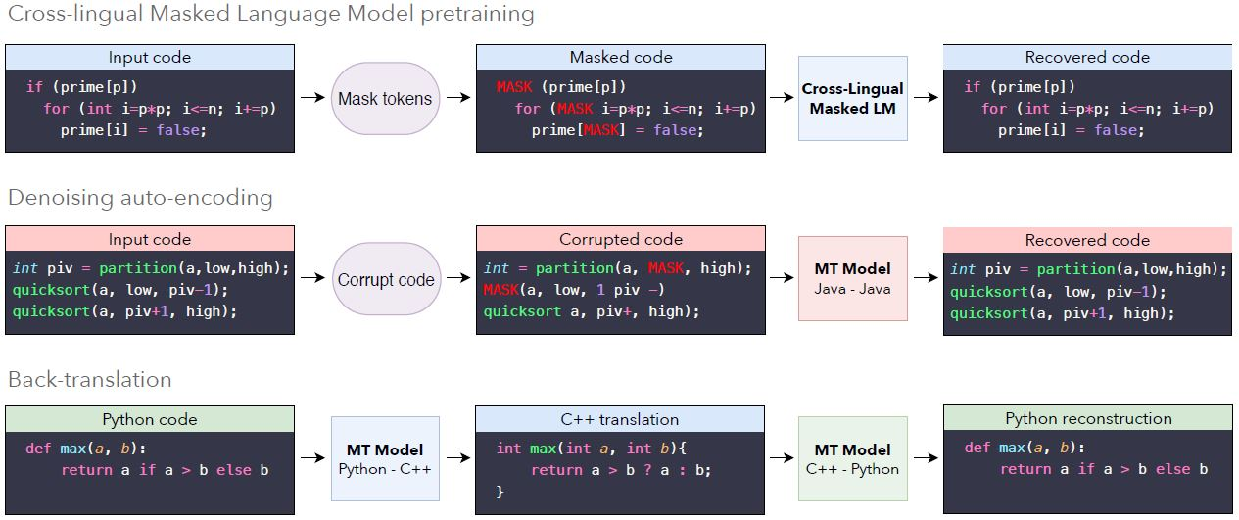
Model
TransCoder uses a sequence-to-sequence (seq2seq) model with attention, composition of an encoder and a decoder with a transformer architecture. This single shared model for all programming languages. It is trained using the three principles of unsupervised machine translation: initialization, language modeling and back-translation.

Slide 5
Model
Cross Programming Language Model pretraining: Pretraining ensures that sequences with a similar meaning are mapped to the same latent representation, regardless of their languages. It is done by initializing the model with cross-lingual word representations. Cross-lingual word embeddings can be obtained by training monolingual word embeddings and aligning them in an unsupervised manner. It leads to significant improvements in unsupervised machine translation.
Denoising auto-encoding: The encoder and decoder of the seq2seq model is initialized with the pretrained XLM model. The model is trained to encode and decode sequences with a Denoising Auto-Encoding (DAE) objective. It allows the model to encode a language even with noise and decode to another language perfectly.
Back-translation: It is essential for boosting the performance. In the unsupervised setting, a source-to-target model is coupled with a backward target-to-source model trained in parallel. The target-to-source model is used to translate target sequences into the source language, producing noisy source sequences corresponding to the ground truth target sequences.

Slide 6
Experiments
Training Details:
Transformer had- 6 layers, 8 attention heads, and set the dimensionality of the model to
1024.
XLM pretraining alternates batches between C++, Java, and Python, composed of 32 sequences of
source code of 512 tokens. At training time the denoising auto-encoding and
back-translation objectives were alternated and batches of around 6000 tokens were used.
Optimizer- Adam optimizer
Learning rate of 0.0001
Implementation is done in PyTorch and trained on 32 V100 GPUs.
GitHub public dataset is used which is available on Google BigQuery4. It contains more than 2.8
million open source GitHub repositories.
For Natural Language Processing tokenizers were used. Javalang5 tokenizer for Java, the tokenizer of the standard library for Python6, and the clang7 tokenizer for C++ were used.
For validation and test set, a set of parallel functions in C++, Java, and Python is extracted from GeeksforGeeks. BLEU score used to evaluate the quality of generated functions.

Slide 7
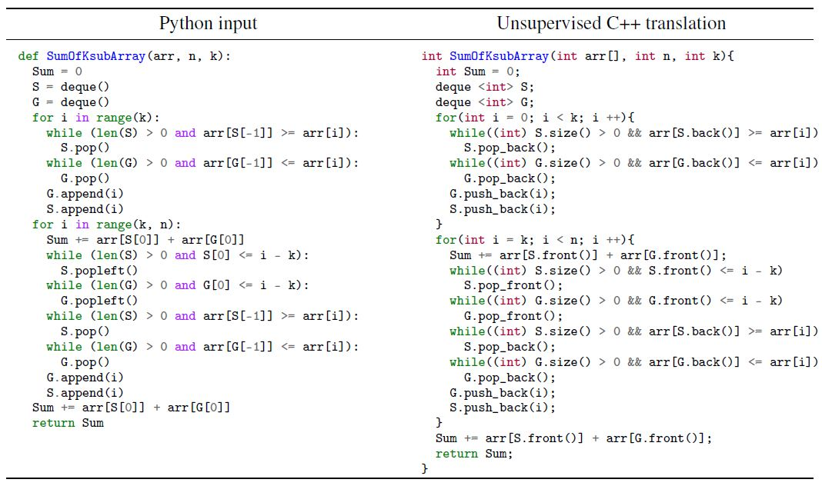
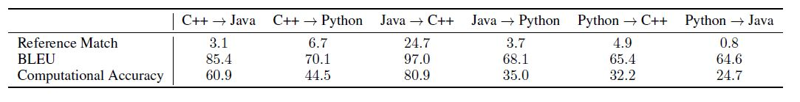
Results
The results shows that the TransCoder successfully map tokens with similar meaning to the same latent representation, regardless of their languages.
Table 1: Results of TransCoder on the test set with greedy decoding.

Slide 8
CONCLUSION

Slide 9
